Slide 1


Engineering Codex
To Infinity and Beyond

Slide 2




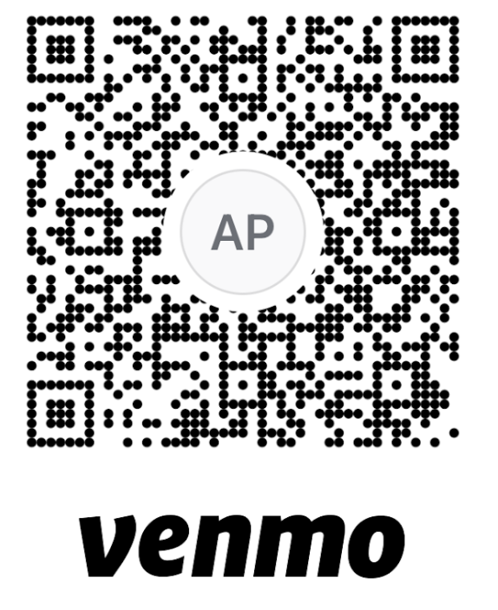
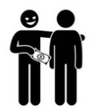


My goal is to empower ourselves with some actionable knowledge,
and inspire curiosity
We can take as long as we want
Questions mean we are learning
Think of this as a conversation
Let’s be kind
To finish earlier...

Slide 3

stands for Global Digital Experience.
Our missions is to enhance the member journey with a seamless digital experience in the warehouse, and beyond!

Slide 4
Kirkland Signature Engineers
Engineering Goals
Costco badged engineers (target 80% employee)
Costco badged product engineering team members (target 90% employee)
Streamline and automate engineering processes
Learnings and expertise stay with Costco
Engineering career paths
Established Costco Product Engineering culture
Standardize stack with architecture
Build Domains
Key Results
100% of Digital traffic goes to modern systems
100% of orders processed through modern OMS system
4.5 star rating for mobile application
50 Digital microservices exist
100 weekly automated deployments to production
Building a village to serve a planet will mean a new type of citizen

Slide 5

“as a fadyng architecte, mine own wish bes that thee be led to cunning and expeditious paths, in construction of the fashion doth noble establishment craveth to arrive at its mark”
R.I.P
Here Lies
Ankur Patel
Architect of Renown
circa 200X - 2025

Slide 6
Engineering (noun):
the action of working artfully to bring something about
Engineering User Journeys
Engineering Teams
Engineering Product Scope
Engineering Infrastructure
Engineering Code
Engineering Tests
Engineering System Architecture
...
Not everyone needs to be called an Engineer, but everyone in GDX is engineering something, and that something is in the aid of delivering new Digital Experiences.

Slide 7
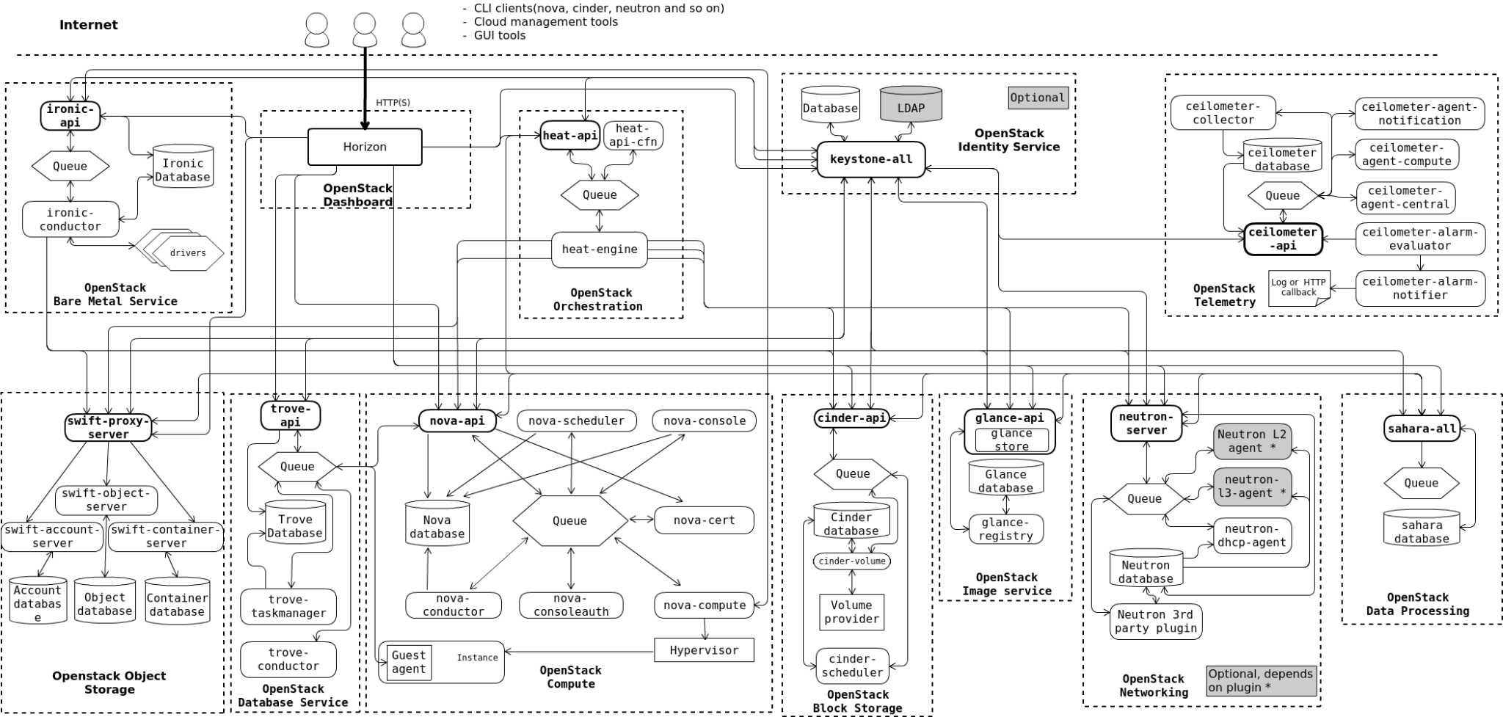
“Architecture is about the important stuff, whatever that is”
-- Ralph Johnson author of Design Patterns: Elements of
Reusable Object-Oriented Software

Slide 8
So Why a New Architecture
Omni-channel
Enhanced Efficiency and Productivity
Scalability and Flexibility
Cost Savings and ROI
Better Security and Compliance
Improved Reliability
Fewer Incidents
Improved User Experience
Self-Managed Maintenance
Reduced Vendor Dependency
No More Big Bang Modernizations
Control of our own Destiny
Cheaper, Faster, Better, and Ready for the Future

Slide 9
Cunning & Expeditious Paths to Modernization

Slide 10
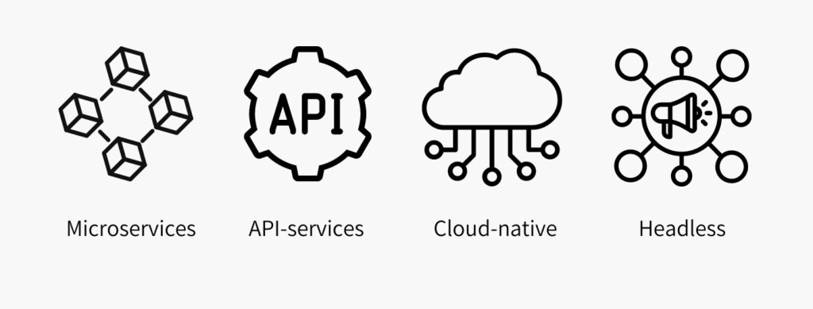
MACH Architecture
Modularity and flexibility.
Scalability.
Speed of innovation.
Technology agnosticism.
Resilience and fault tolerance.
Vendor independence.
Greater customer satisfaction
Speed to market into new geographies.
Improved operational efficiency.

Slide 11
Microservices APIs
No 2 services should share the same domain model
Scope of a service cannot go beyond the boundary of a single bounded context
Discoverable via the use of ubiquitous language
Horizontally scalable
Technology agnostic
Independent code repos
Aggregates should be represented via multiple microservices
Chattiness should be resolved through API composition not API creation
The “Micro” in Microservice is about scope, not size, and scope is focused towards the specific problems of a singular bounded context.

Slide 12
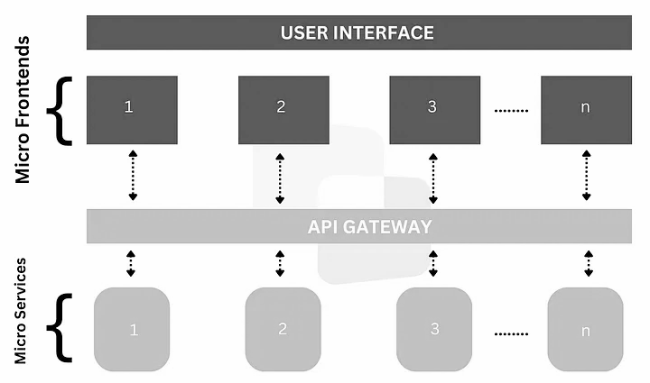
Micro Front End Architecture
Benefits:
Independent Development and Deployment
Enhanced Scalability and Maintainability
Technology Flexibility
Improved Team Collaboration and Autonomy
Pay Attention To:
Communication and Data Sharing
Routing and Navigation
State Management

Slide 13
GDX Consumer Web Tenant
GDX Consumer Mobile Tenant
GDX Business Web Tenant
GDX Business Mobile Tenant
Browse.web
Android.app
Buyer.biz
Delivery.app
Product.web
IOS.app
Marketer.biz
Tenant APIs
Search.web
Tenant APIs
Cs.biz
...
Checkout.web
...
Orders.biz
My.web
Forge.biz
Forge.web
Tenant Services
Tenant APIs
...
...
Domains APIs
What Are We Modernizing To?

Slide 14
Tenant Architecture
User Insights
UX Design
System
telemetry to
leverages
Domain
API Compositions
UX Experiences
Lightweight - Implements Experience Logic not Business Logic
Loosely Coupled - Communicate via Events and APIs
Not an SOR - Not allowed to mutate business data within itself
Isolated - Don't talk to or impact each other
Bounded - Defined by their audience and delivery mechanism
calls
calls
calls
Tenant
Events
sends
event to
Tenant SDK APIs
calls
Domain
Events
Tenant Workload
Processors
subscribes to

Slide 15
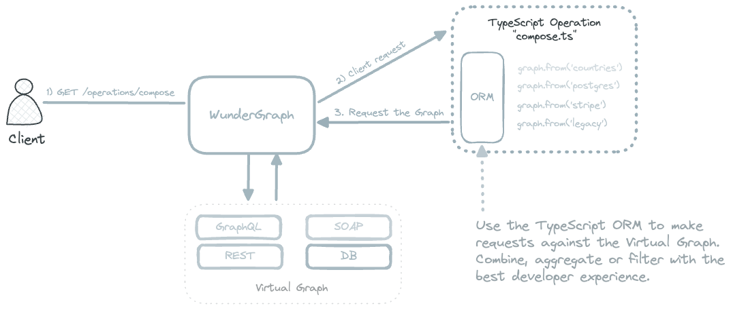
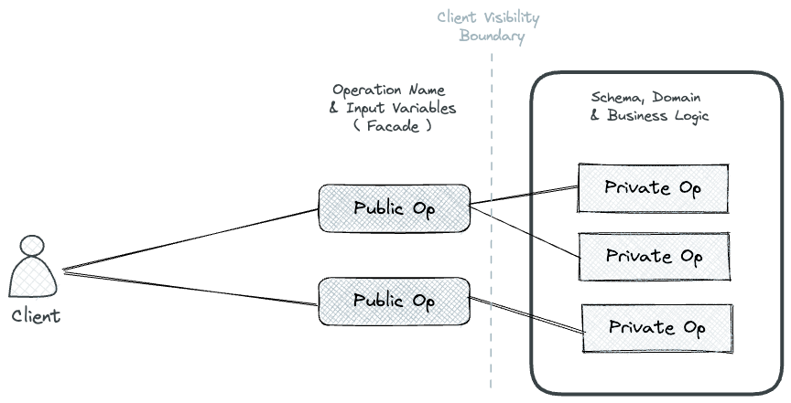
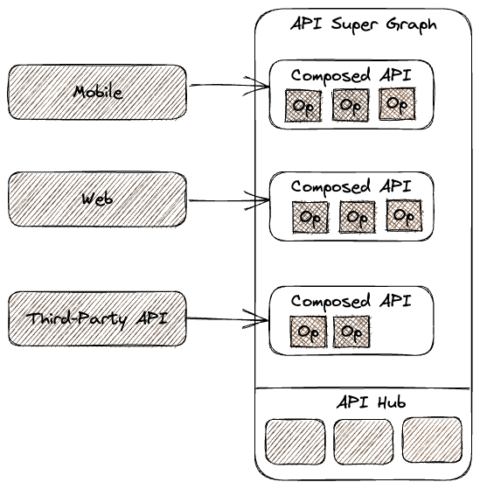
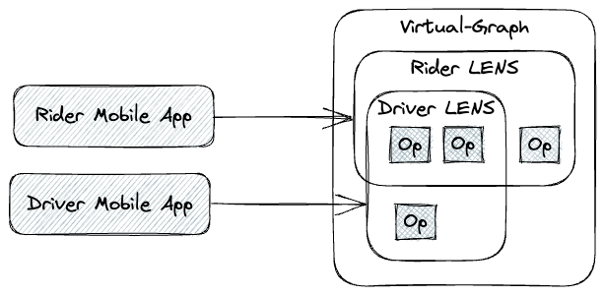
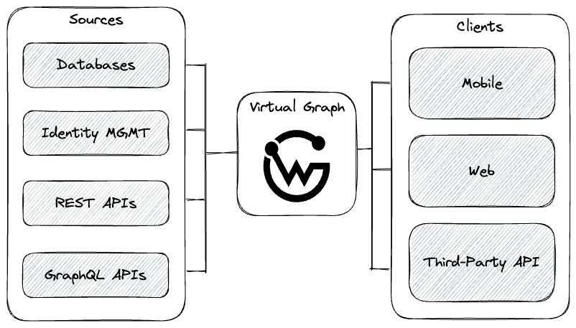
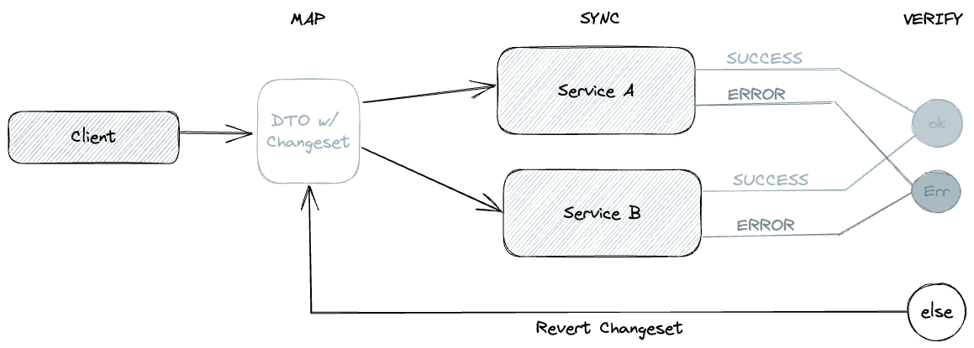
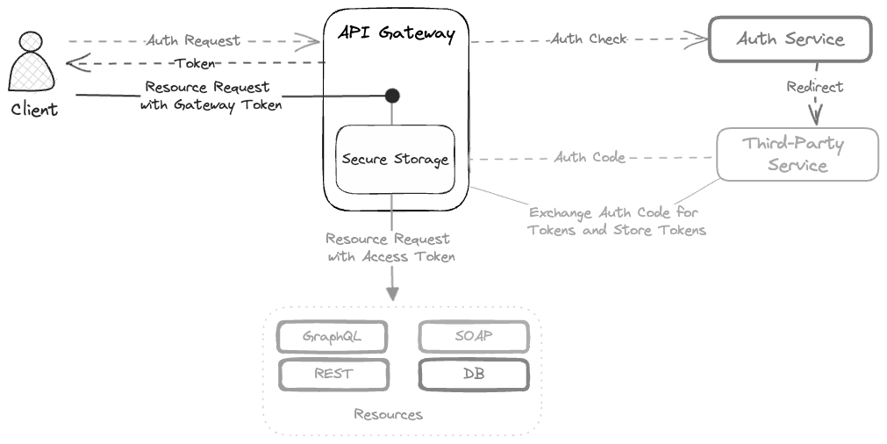
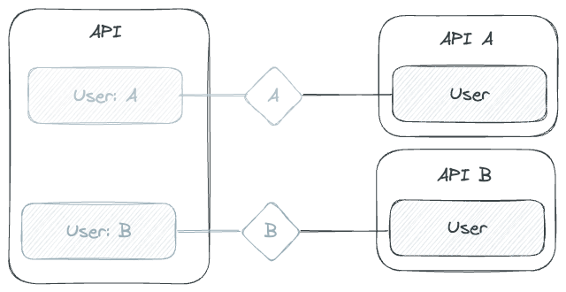
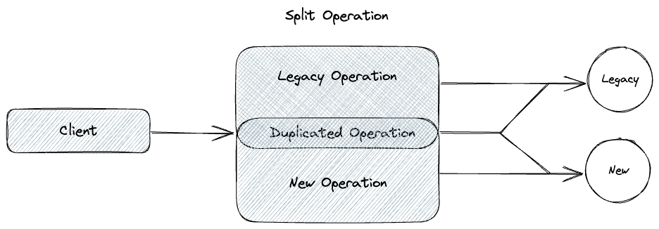
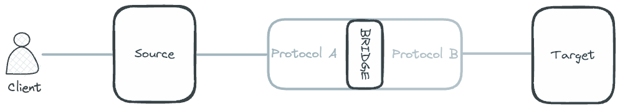
A Note about BFFs
single integrator
Backend for Frontend (BFF) is a pattern for implementing an API that tailors it for different clients or user interfaces, such as web, mobile, or other Domains.
Instead of having a single API for all clients, BFFs provide customized APIs that cater to the unique needs and requirements of each client, ensuring efficient communication and an optimized user experience.
There are many other API patterns, that we might deploy to solve varied problems in specific use cases.
Tenant APIs are not all BFFs
facade
composer
lens
bff
coordinator
token handler
transformation bridger
namespacer
evolver

Slide 16
TENANTS
ARE INCUBATORS FOR GROWING SOLUTIONS THAT DELIGHT OUR CUSTOMERS
Tenants provide an ecosystem to rapidly introduce and test new user interactions, and to solidify good ideas into lasting memorable experiences

Slide 17
Warning the Following Slide Contains Color

Slide 18

stands for Global Digital Experience.
We should only have to assemble digital experience heads, aka Tenant applications, but as an organization, Costco does not have enterprise data APIs for us to consume today. We will need to fill the gaps ourselves.

Slide 19
Consumer Mobile Tenant
GDX Business
Capabilities
Domain
Enterprise
Capability
Domains
Consumer Web Tenant
Business Mobile Tenant
GDX
Developer Platform
Enterprise
Cloud
Domain
Business Web Tenant
What Are We Really Building Today?

Slide 20
GDX Capability Domain
Basket
Provide storage for products carefully chosen by shoppers, and the tools to allow them to evaluate those selections and finalize their commitment to do business with us.
Catalog
Provide shoppers with the tools to discover our brand, products and services, and drive their excitement to do business with us.
Identity
Provide shoppers with a digital representation of themselves, and the tools to manage this representation, in terms of preferences and associations to other digital identities.
Provide business users with secure and trusted access to the tools they need.
Inventory
Provide shoppers with the tools to accurately determine the availability of goods and services, so they can make informed purchasing decisions.
Provide business users with the tools to determine demand, in order to delight shoppers.
Item
Provide business users with the tools to manage purchasing options and shipping constraints for items sold digitally, and to meet the financial and regulatory requirements of selling online.
Order
Provide business users with the tools to efficiently process orders and returns.
Provide shoppers with the tools to manage and view the current state of their orders, and returns.
What are the Business Capabilities We Need?

Slide 21

We’ll Return to “To Infinity and Beyond” After This Quick Educational Announcement

Slide 22
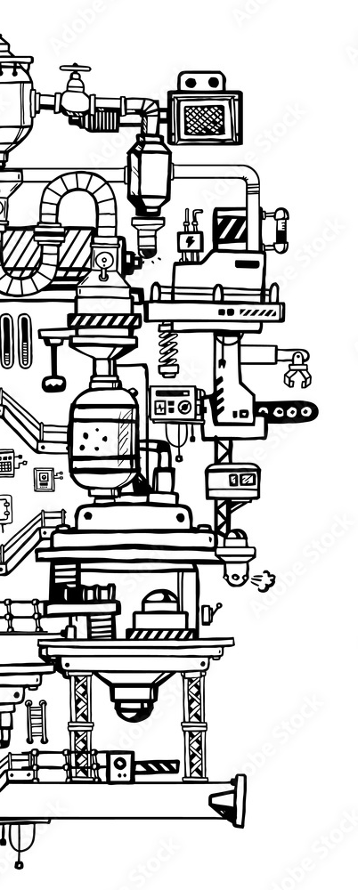
“Day 458, since the machines took over, there’s nothing left of the city or the world. There’s only a handful of survivors, but there’s still hope.”

Slide 23
The 4 Laws of Architecture
Moore’s Law (1965)
Amdahl’s Law (1967)
Conway’s Law (1964)
Galls Law (1975)
Architecture does not have many absolutes, but over the last 40 years, 4 ideas have been observed to be true often enough, so as to be held as fundamental laws of system design.

Slide 24
Moore’s Law
The law was sound until we hit the limit of how many transistors fit into a CPU.
Multicore packaging of CPUs was the answer to be able to make faster computers
You can scale up until you can't then you have to scale out.
The Number of Components in an Integrated Circuit will Double Every 2 Years

Slide 25
Moore’s Law is telling us to scale out to get more done.

Slide 26
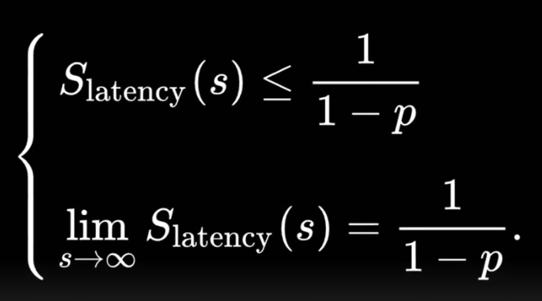
Amdahl’s Law
One person cooking thanksgiving dinner takes 10 hours.
Add more chefs and you can do it faster
But you can never get faster than the time it takes to cook the turkey.
If you get more guests and need more turkey, you’re in trouble
If you want to go really fast, you have to build systems with out turkeys.
Rethink Dinner, Thanksgiving Burritos!
Christmas Turkey

Slide 27
Amdahl's law is telling us we can never get faster than the slowest thing we do atomically.

Slide 28
Conway’s Law
Systems are composed of individual components.
Components can only be known in totality by a few
The connections between components require a interface which requires negotiation
The system you produce mirrors the quality of an individual's ability to negotiate across the organization
“Any Organization that designs a system (defined more broadly here than just information systems) will inevitably produce a design whose structure is a copy of the organization's communication structure”

Slide 29
Conway’s Law is telling us that our system will mirror our organization.

Slide 30
Gall’s Law
Simplicity is a prerequisite for complexity.
“Systems are seductive”
Avoid over engineering
Learn from experience
Resist premature optimization
Complex
“A complex system that works is invariably found to have evolved from a simple system that worked. A complex system designed from scratch never works and cannot be patched to make work. You have to start over with a simple working system”

Slide 31
Gall’s Law is telling us that a complex system that works has evolved from a simple system.

Slide 32
Bonus Law

Slide 33
Ankur’s Law
Individuals will seek to be autonomous, and avoid having to negotiate
In avoiding negotiation, they will assume scope
In assuming Scope they will increase the complexity of their system
As a systems complexity increase it will start resembling a monolith
No matter the architecture of a system at its outset, its components will evolve towards being monoliths over time

Slide 34
What does it all mean?
Moore’s Law - Scaling out is the only way to do more.
Amdahl’s Law - to take advantage of distributed computing, eliminate non parallelizable tasks
Conway’s Law - if you don't want to introduce non parallelizable tasks in your systems you shouldn't have them in the structure of your teams
Gall’s Law - Build the simplest solutions to address each nuance of our complex problems, and we’ll have solved our complex problems.
Ankur’s Law - Over time perfection will be undone by complexity.
To do more, design simple systems, that require the minimal amount of negotiation, made up of small parallelizable workloads, delivered atomically, and refactored periodically

Slide 35
And Now, Back to Your Regularly Scheduled Presentation

Slide 36
GDX Capability Domain
Basket
Provide storage for products carefully chosen by shoppers, and the tools to allow them to evaluate those selections and finalize their commitment to do business with us.
Catalog
Provide shoppers with the tools to discover our brand, products and services, and drive their excitement to do business with us.
Identity
Provide shoppers with a digital representation of themselves, and the tools to manage this representation, in terms of preferences and associations to other digital identities.
Provide business users with secure and trusted access to the tools they need.
Inventory
Provide shoppers with the tools to accurately determine the availability of goods and services, so they can make informed purchasing decisions.
Provide business users with the tools to determine demand, in order to delight shoppers.
Item
Provide business users with the tools to manage purchasing options and shipping constraints for items sold digitally, and to meet the financial and regulatory requirements of selling online.
Order
Provide business users with the tools to efficiently process orders and returns.
Provide shoppers with the tools to manage and view the current state of their orders, and returns.
What are the Business Capabilities We Need?

Slide 37
Catalog Domain
Basket
Domain
C
Persona
inventory
associations
Orders
Identity
Domain
Inventory Domain
inventory
reservations
Order
Domain
Item
life cycle
inventory
adjustments
Item
Domain
item
life cycle
B
Telling the Domain Story of our System

Slide 38
Domain
Architecture
Domain API
queries
executes
calls
Domain & Subdomain
Processes
Bounded- Has a clear and distinguishable responsibility separating it from other Domains
Autonomous - Is independent and self-contained with minimal dependency on other Domains for its functionality or behaviour
Integratable - Open to communication from tenants and other Domains
Encapsulated - hides its internals and exposes only well defined interfaces for API’s & Events, with versioned, consistent contracts
SOR - Is the system of record for the entities is exposes
writes
to
Other Domains or Tenants
subscribes
to
Transactional
Data
subscribes
to
publishes
replicated
to
Domain
Events
Operational
Data

Slide 39
DOMAINS
ARE HOW WE IDENTIFY THINGS
Domains are problem areas, the let us build a ubiquitous language with which to identity and address areas of concern

Slide 40
SUBDOMAINS ARE WHERE WE INNOVATE TO SOLVE THE PROBLEMS OF OUR USERS
Subdomains represent a nuance in a Domains problem area, where we establish behaviours that reduce friction against that area

Slide 41
Identity.Address
Provide shoppers with the ability to store and manage their addresses
Identity.Payment
Provide shoppers with the ability to store and manage their payment information
Identity
Provide shoppers with a digital representation of themselves, and the tools to manage this representation, in terms of preferences and associations to other digital identities.
Provide business users with secure and trusted access to the tools they need.
Identity.Loyalty.Costco
Provide shoppers with the ability to manage their Costco Membership
Identity.Loyalty
Provide shoppers with the ability to manage their memberships to various loyalty programs
Identity.Loyalty.Instacart
Provide shoppers with the ability to manage their InstaCart Membership
Identity.Notifications
Provide shoppers with the ability to store their communication preferences, and receive notifications based on those preferences.
Solving Complex Problems by Compartmentalizing

Slide 42
Sub Domain
Architecture
Other Domains or Tenants
subscribes
against
transacts
against
Domain APIs
Domain
Events Registry
Cohesive - has a single responsibility and clear purpose within the context of its parent domain
Focused - Includes only the relevant aspects of its own context, and avoids unnecessary complexity
Explicit - Makes context rules clear and explicit
Encapsulated - hides its internals and exposes only well defined interfaces for API’s & Events, with versioned, consistent contracts
SOR - Is the system of record for the entities is exposes
exposes
proxies or composes
Sub Domain
Business Events
Sub Domain
APIs
mutations emitted as
transacts against
Sub Domain Aggregates
(Clusters of related Entities & VOs) )
Sub Domain
Repositories
Sub Domain Entities
(Identity, State)
encapsulates
Sub Domain VOs
(No Identity, No State)
Sub Domain
Business Rules

Slide 43

DOMAINS AND SUBDOMAINS ARE NOT DATA
MODELS, THEY
ARE BEHAVIORALLY BOUNDED CONTEXTS

Slide 44
The Developer Domain is the universe in which our solutions live
It's an energy cloud created by all developed things. It surrounds them and penetrates them. It binds the GDX together

Slide 45
Internet
SaaS Clouds
Google Cloud
Azure Cloud
Wenatchee
Data Center Ecomm
Wenatchee
Data Center Enterprise
GDX Infrastructure

Slide 46
GDX Developer Domain
Application
Data
Runtime
Middleware
Empowers teams to deliver highly reliable solutions both quickly and efficiently
Allows app teams to focus on business value by reducing the cognitive load of cloud native applications
Establishes patterns to accelerate organizational learning and cross-team collaboration
Delivers security and governance through automated processes, conventions and best practices
Provides self-service capabilities to enhance developer productivity
Operating System
Governance
DevEx (Automation and CI/CD)
Observability
Security
Virtualization
Network
Storage
Servers

Slide 47
What does it all mean?
Developer Domain
Tenant
Tenant
Tenant
user experience
user experience
Tenant Enabler
user experience
Tenant Enabler
Tenant Enabler
user experience
user experience
user experience
Domain
Domain
Domain
We have a Northstar Architecture and its neatly broken down into granular but manageable problem areas that are loosely coupled and can be evolved independently.
subdomain
subdomain
subdomain
subdomain
subdomain
subdomain
subdomain
subdomain
subdomain
Domain Capability
Domain Capability
Domain Capability
Domain Capability
Domain Capability
Domain Capability

Slide 48
PORTFOLIO
Collection of product groups whose value delivery shares a high degree of dependency
GDX
VP
Evergreen
Defines Value
PRODUCT GROUP
Collection of common products whose value shares a high degree of dependency
Individual Tenants
Individual Domains
Dev Domain
AVP/Directors
[Cost Center]
PRODUCT
Persistent grouping of applications, technology, talant, and data that enables a specific outcome of capability
Tenant Experience
Domain
Dev Domain Capability
Product Manager/ Owner
Utils & Services
Implementation of a service, consumed by an end-user, business function or other service
To build the modular, distributed & composable architecture we desire, we need to transition to a product operating model. Clear understanding of areas of responsibility are essential to keeping communication lean, and delivery efficiently
Ephemeral
Delivers Value
Application
Software deployed to enable a business or technology function
Service Configuration
Technologies & processes that deliver a service offering
The GDX Product Portfolio

Slide 49
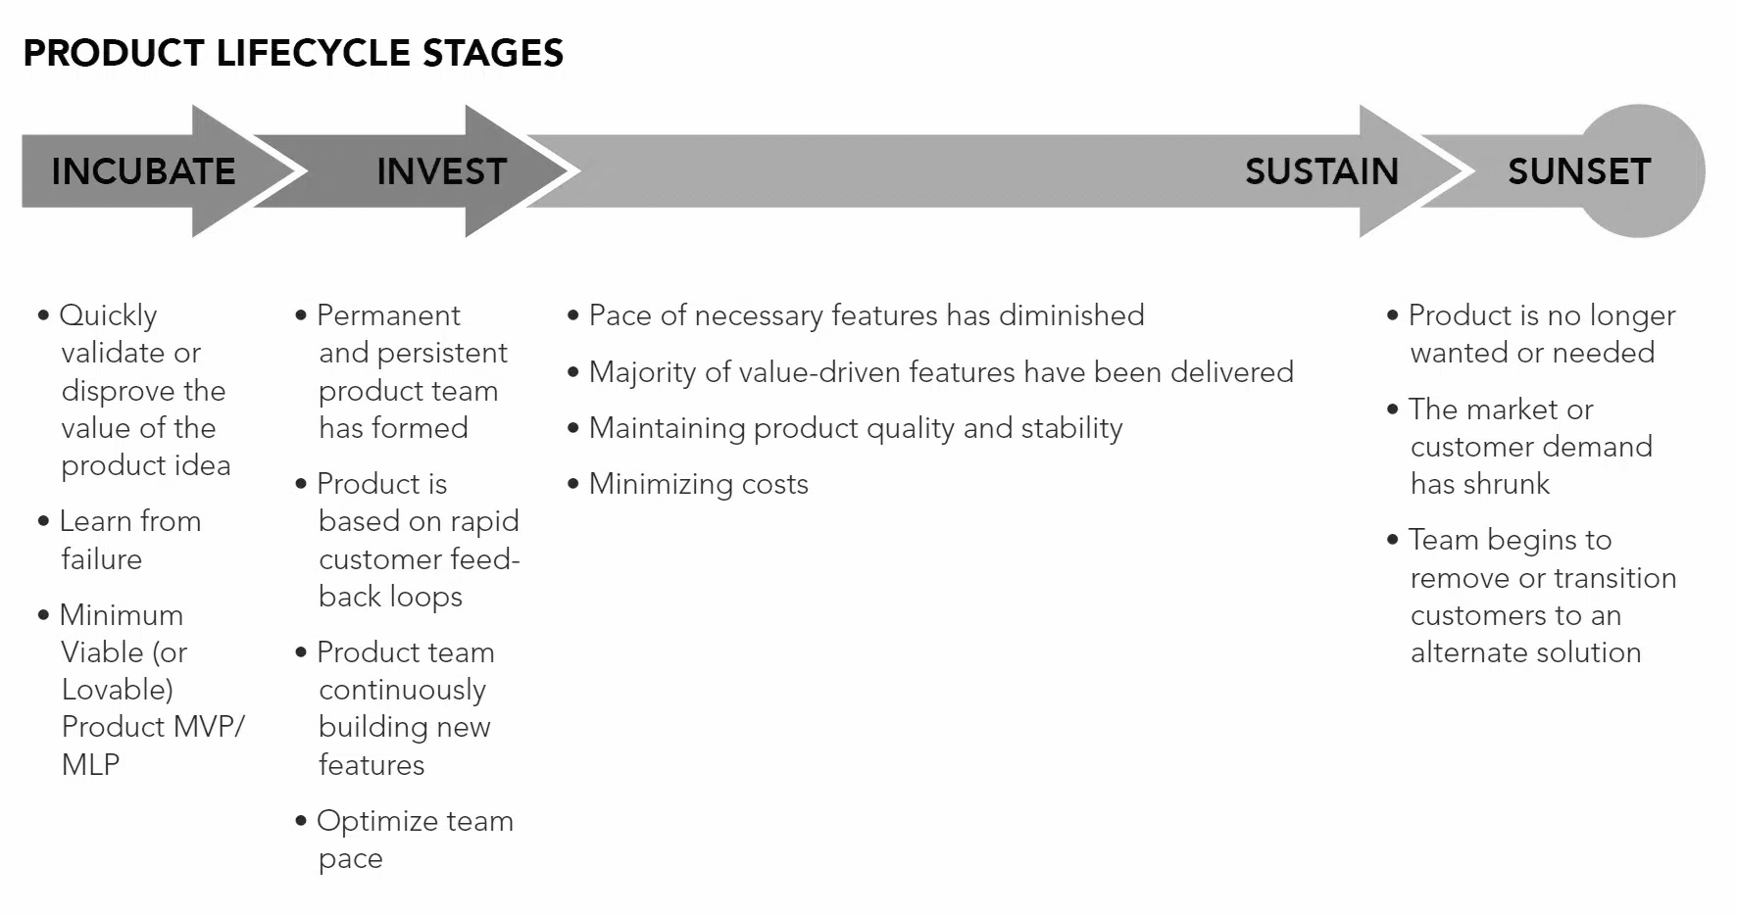
The Lifecycle of a GDX Product

Slide 50
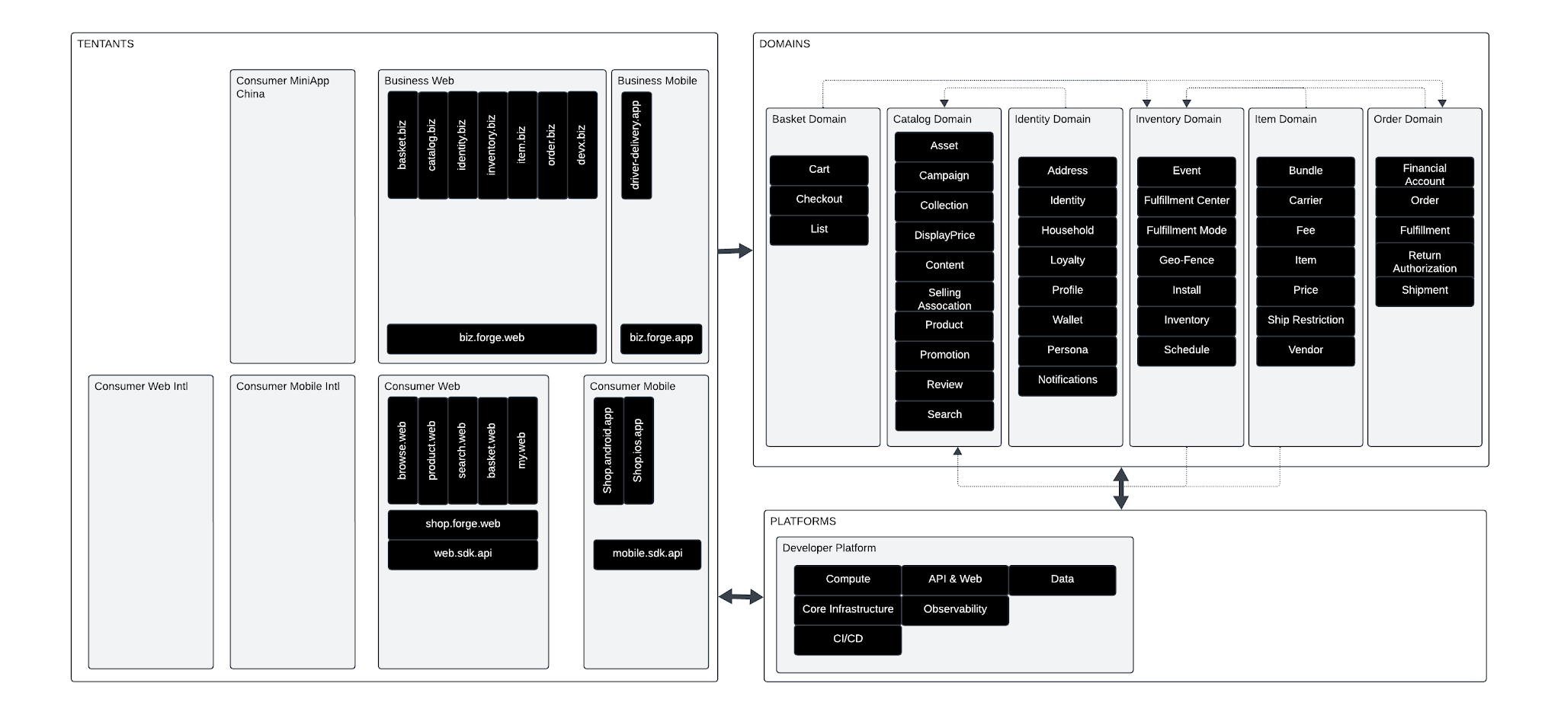
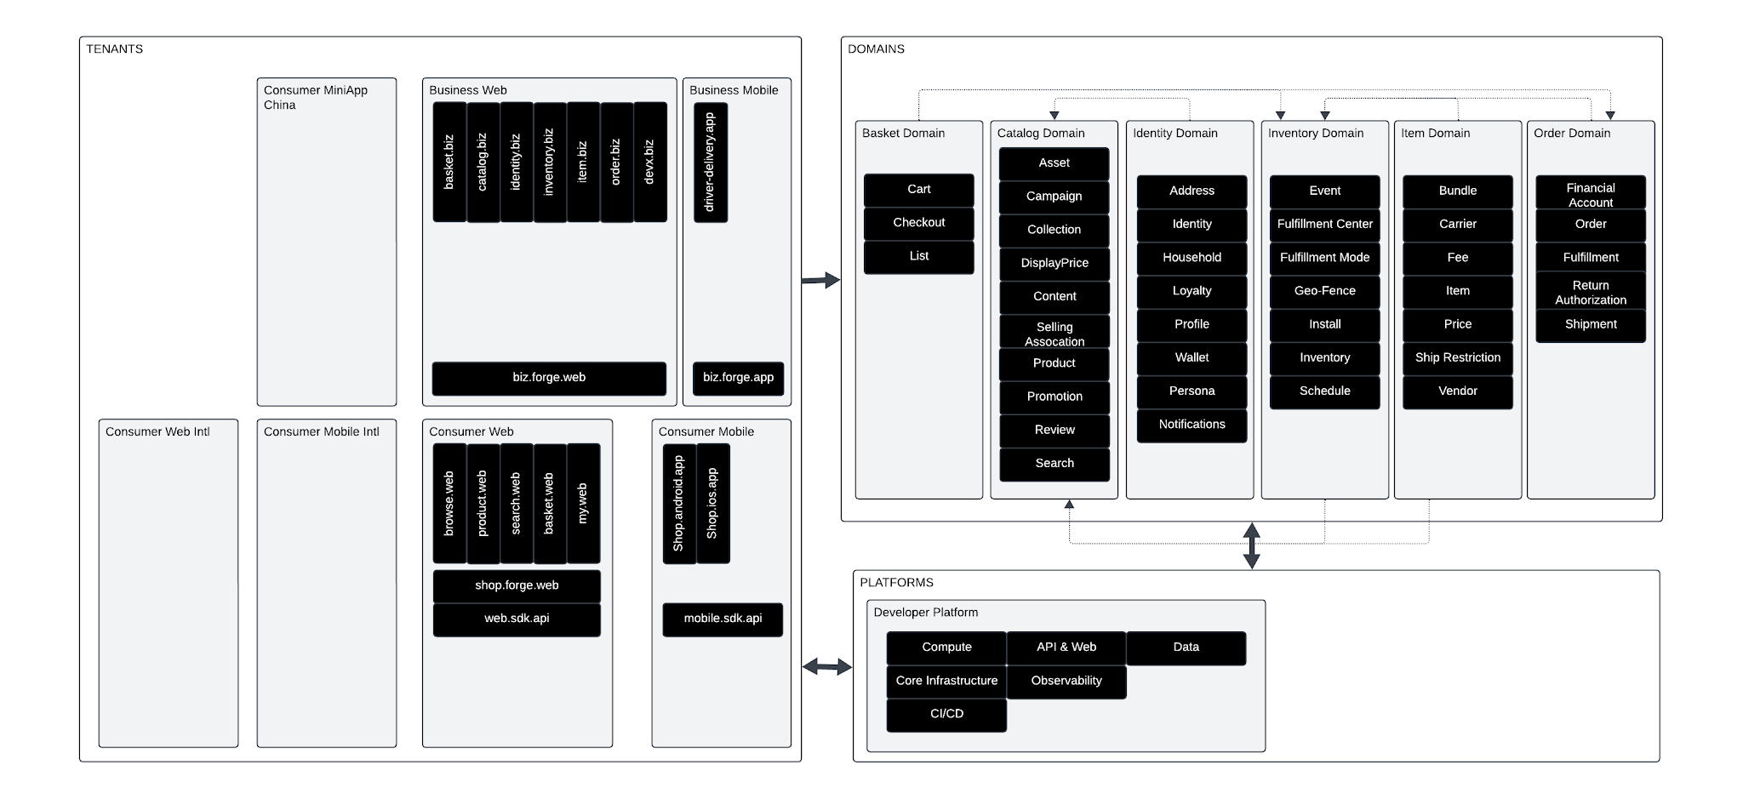
Our Zero-Day Portfolio

Slide 51

OUR PORTFOLIO IS OUR UBIQUITOUS LANGUAGE

Slide 52
How The Heck Can We Deliver Against This Monster?
Review business intake
Convert to a GDX tenant user dialog(s)
Generate supporting GDX tenant dialogs
Catalog the dialog(s) as a user journey in an evergreen backlog
Generate dialogs for Domains touched in the journey
Set an execution order
Distribute work items for each dialog activity
Execute!
To do more, design simple systems, that require the minimal amount of negotiation, made up of small parallelizable workloads, delivered atomically, and refactored periodically

Slide 53
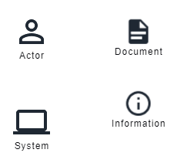
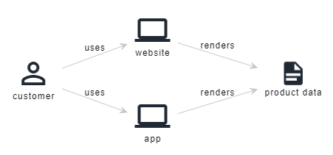
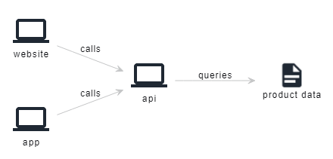
Domain Dialogs/ Domain StoryTelling
Dialoguing or Storytelling Toolkit
One Cunning method to decompose complex problems is Domain dialoguing or storytelling.
It helps to:
Understand a domain
Establish a shared language between domain experts and IT experts
Fully align all project participants and stakeholders, both technical and business-focused
Draw clear boundaries to organize your domain, software, and teams
Designing viable, software-supported business processes
Transform domain knowledge into requirements, embedded naturally into an agile process
Gain better visibility into your IT landscape so you can consolidate or optimize it
Shopper Browsing Products
User Experiences Retrieving Product Data

Slide 54
Uh huh!
User journey: Is a technique for describing how the user interacts with our business (and business systems) over time to realise an end goal
User story: Is a technique to describe specific functions the user must perform at each stage of a journey. It describes how a user interacts with our business or business system at a point-in-time
Domain story: Is a technique for capturing the behaviour and actions of the user with our systems and the deeper impact of this action to our systems and its subsystems.
It is a way to describe what happens to our business information systems when a user interacts with them.
I’ll just keep using User Journeys or Stories, Thanks

Slide 55
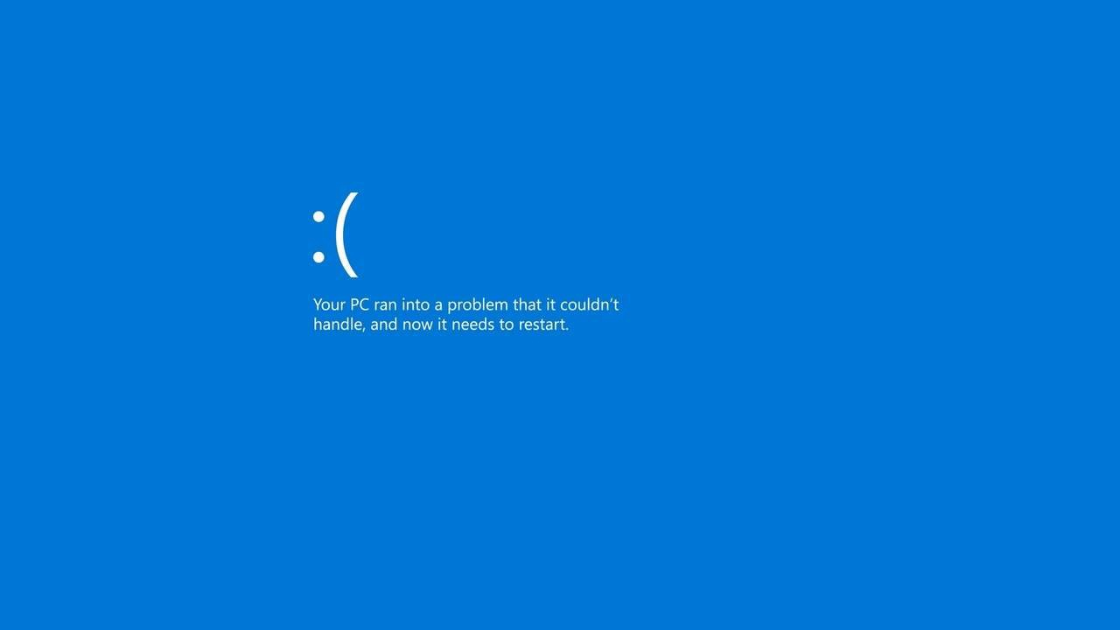
Notes:
https://docs.google.com/document/d/18kS_c-Om3rD9jYABqRDsyaVIPcRFZG7HHmiub-spqKw/edit?tab=t.0

Slide 56

I thank thee for thy thoughtful regard, and I do eagerly await to behold what cunning and expeditious paths each of ye shall forge to bring our endeavor to fruition."
-- Ankur Patel
Architect of renown circa 200X - Infinity and Beyond

